Slide 1
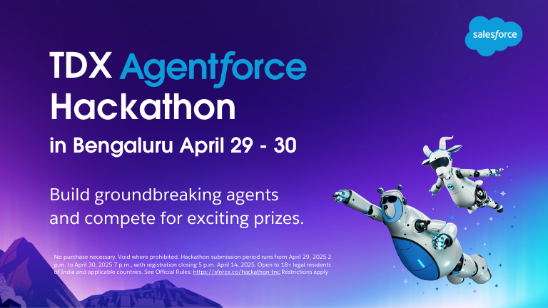
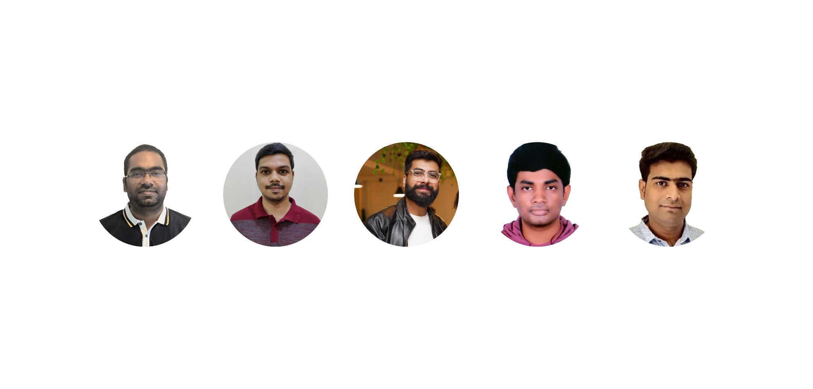
“Guardian Angel” by Team GAgentX
Srikanth Gundabolu
Ashish Gudekar
Deepak Kumar
Suraj Lal Gupta
Avish Samdani

Slide 2
Our Vision & Mission: A Safer Tomorrow
Our Guiding Principles: Vision & Mission
Vision:
To ensure every Indian facing a medical emergency receives immediate, intelligent, life-saving help through connected technology.
Mission:
To save lives by empowering patients, first responders, and healthcare providers with 'Guardian Angel,' an AI-driven emergency response system on Salesforce that uses real-time data and seamless communication to dramatically speed up response and improve care.

Slide 3
The Problem: When Every Second is a Lifetime
The Crisis: Information Gaps & Delays in Emergency Healthcare
Key Challenges:
Delayed Response: Critical minutes lost in dispatch and locating patients.
Information Black Holes: Vital patient history (allergies, conditions) often missing, leading to risky guesswork.
Fragmented Communication: Disconnect between patient, ambulance, and hospital ED.
Overwhelmed Systems: Hospitals struggle to prepare for emergencies without prior, accurate information.

Slide 4
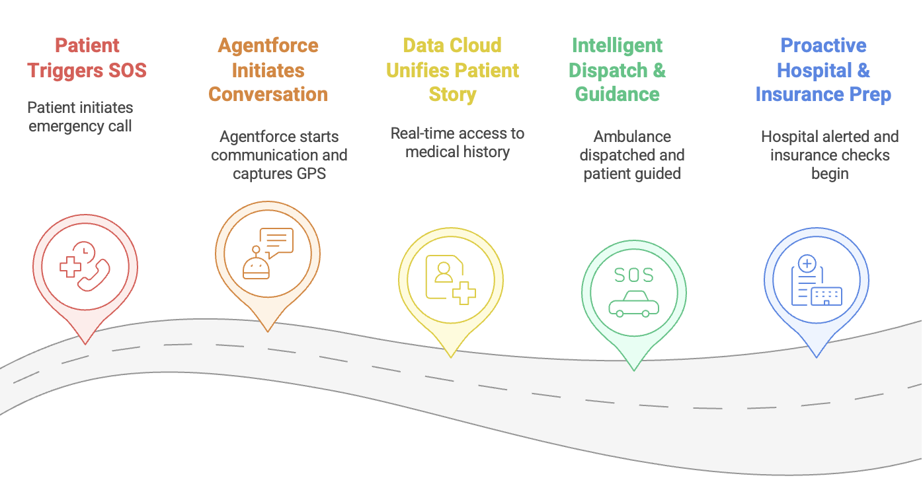
Solution: Introducing "Guardian Angel" - Your Lifeline

Slide 5

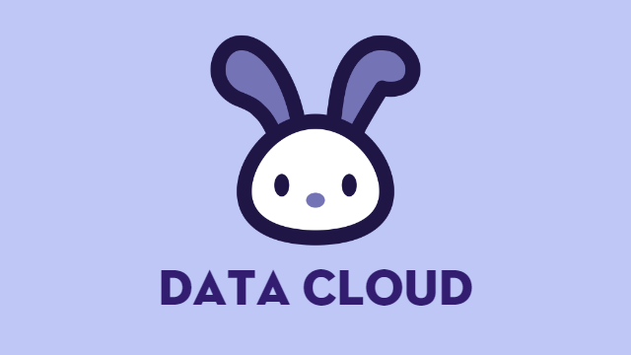



Tech Stack

Slide 6
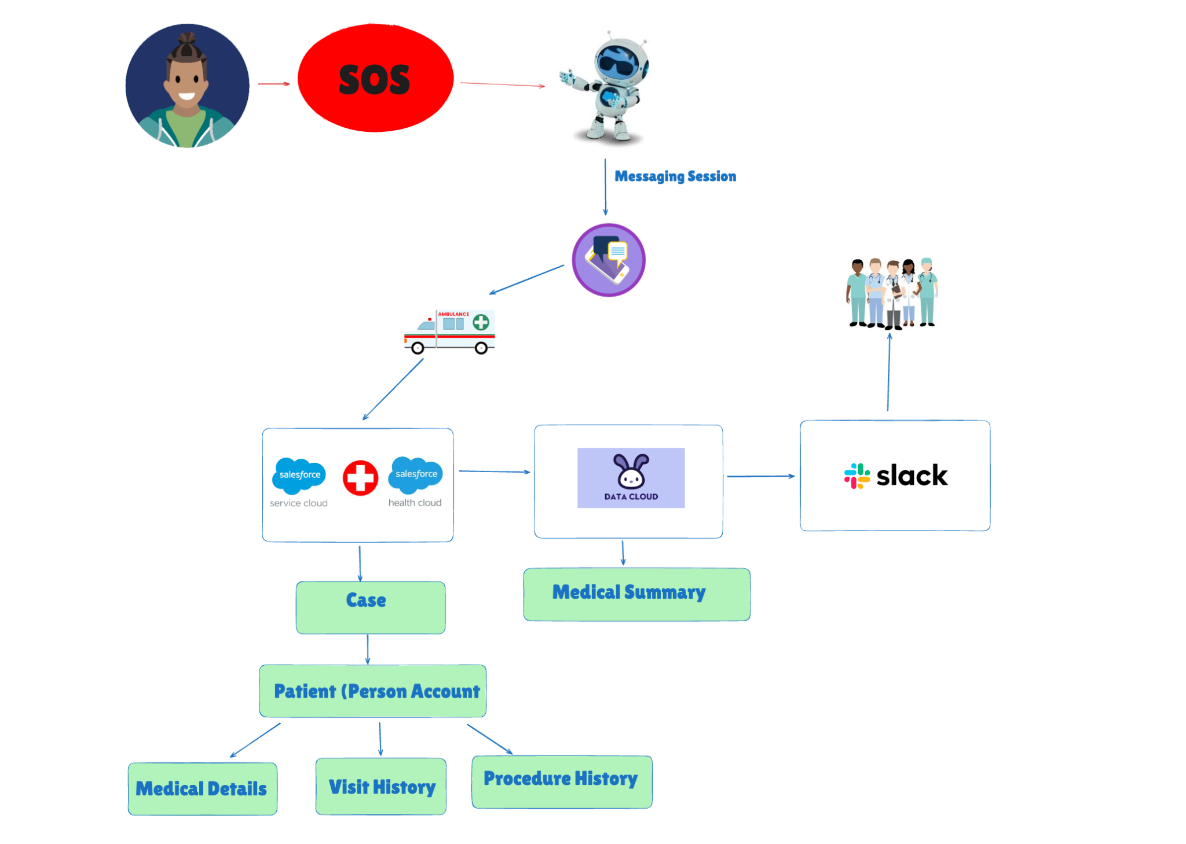
Guardian Angel - Object Architecture

Slide 7
Business Value & Impact: Why Guardian Angel Matters
For Patients & Families:
Faster, Life-Saving Response: Reduced dispatch times, accurate location.
Safer Care: Critical medical history (allergies, conditions from Data Cloud) available to care teams, preventing errors.
Reduced Stress & Anxiety: Reassuring AI guidance, proactive communication.
For Hospitals & Healthcare Providers:
Enhanced ED Preparedness: Teams receive rich patient summaries in advance.
Improved Patient Outcomes: Better-informed decisions lead to better care.
Increased Operational Efficiency: Streamlined intake, automated insurance pre-checks, optimized resource allocation.
Reduced Readmission Risks: Better initial emergency care can prevent complications.
Notes:
Data cloud contains all the medical related details of the patient. Medical summary can be ingested by multiple systems which will then be shown in Salesforce UI

Slide 8
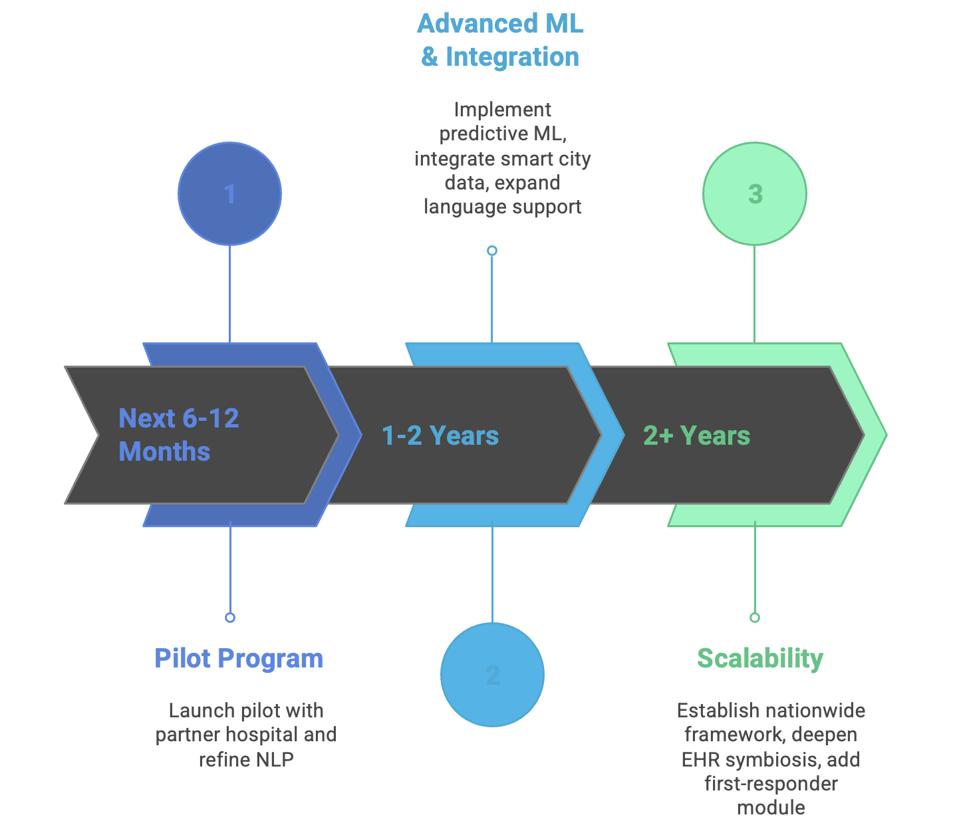
Future Enhancements & Roadmap: The Journey Ahead

Slide 9
Future Enhancements
Real-time Vitals Monitoring via Wearable Integration
Automated Emergency Contact Notification & Updates
Multi-lingual Support with Real-time Translation
Dynamic Ambulance Routing with Traffic Integration
AI-Powered Symptom Analysis & Preliminary Triage Support
Post-Emergency Follow-up Automation
Offline Capabilities for SOS Trigger & Basic Info Caching
Guardrails for Responsible AI

Slide 10
Why Guardian Angel?
Proactive Safety via Data Cloud: Beyond data retrieval to active harm prevention.
True End-to-End Orchestration: From SOS to a fully briefed ED.
Empathy-Driven AI: Designed for human reassurance in crisis.
Directly Addresses Indian Healthcare Needs: Locally relevant, globally innovative.

Slide 11
Thank You
"Guardian Angel is more than a hackathon project; it's a viable, impactful solution ready to transform emergency care. We believe in its power to save lives."
Contact Information: surajlalgupta@google.com; deepakkumr@google.com
GitHub Link: https://github.com/ASHISH0410/GAgentX
"We welcome your questions and are excited to discuss how Guardian Angel can make a real difference."

